Slide 1
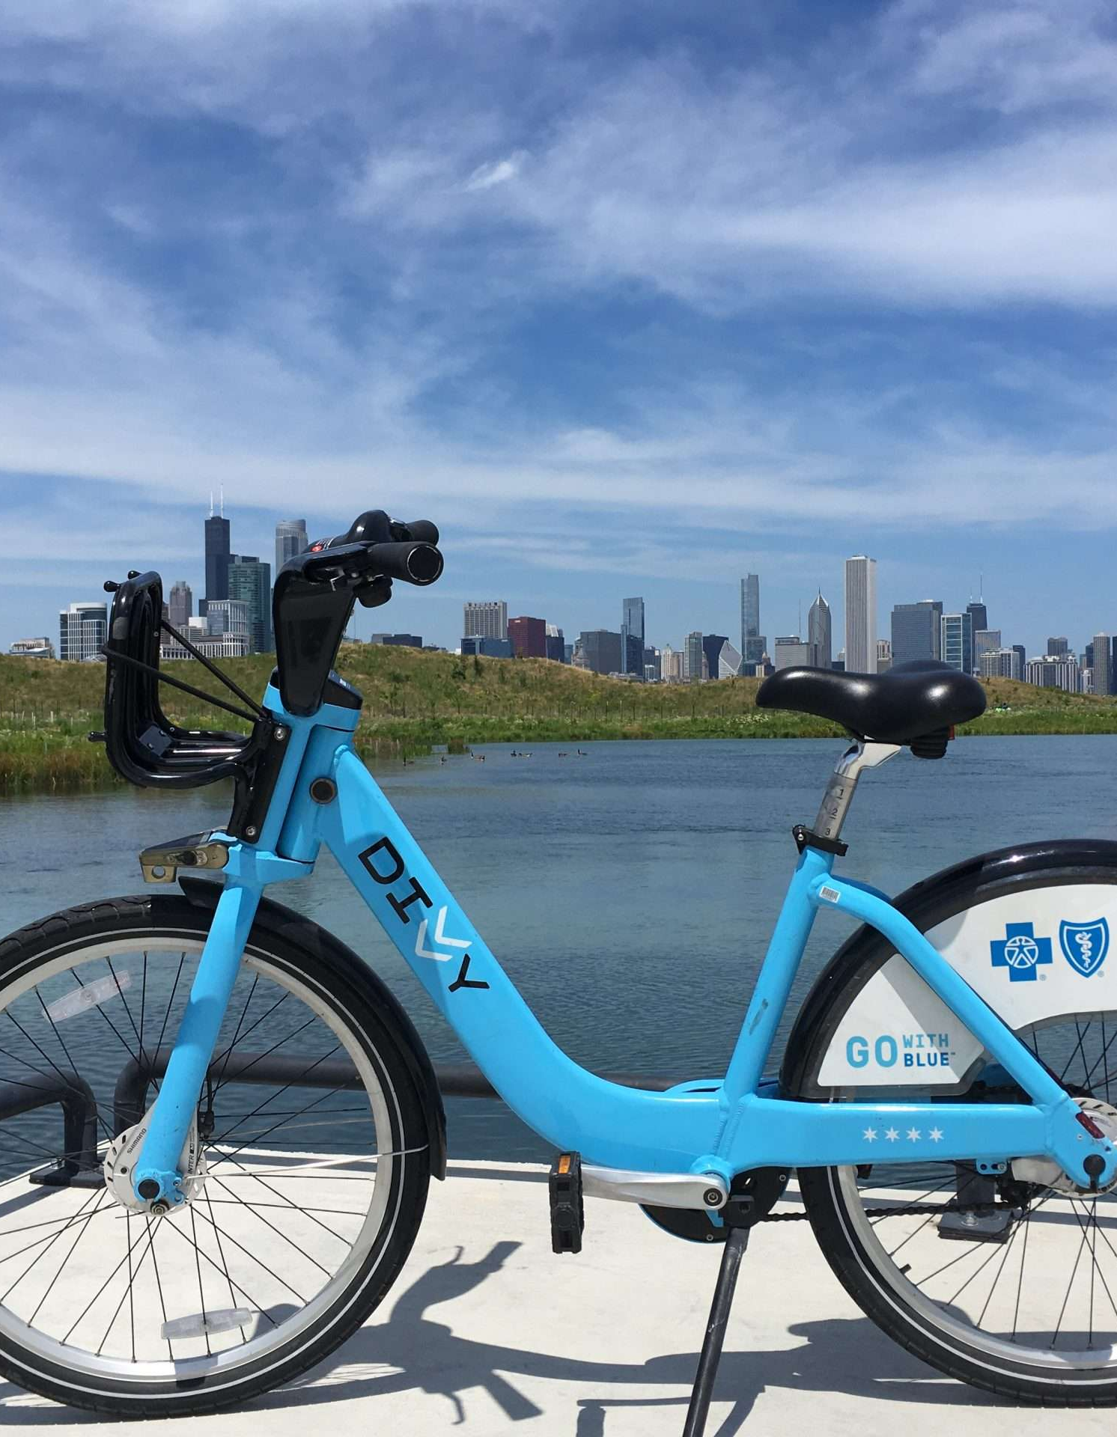
Pedals & Pathways: A Strategy to Capture Commuters and Urban Explorers as Loyal Members
Recommendations for Converting Casual Riders to Long-Term Customers
Donnie Minnick
January 2024
Notes:
Welcome to today’s session! Our goal today is to share insights gained from analysis of our ridership and, based on those insights, recommend actions that will transition casual riders into committed, long-term members.
A story emerged from our data analysis, and we will talk about how annual memberships can not only make commuting cost effective but also open up a world of urban exploration.
The practicality of commuting benefits combined with the allure of urban exploration has the potential to resonate with a wider audience, attracting both those seeking a reliable daily commute solution and those looking for exciting ways to experience their city.
Using our analysis, we will dissect the intersection of convenience and adventure offered by Cyclistic's bike-sharing service.

Slide 2
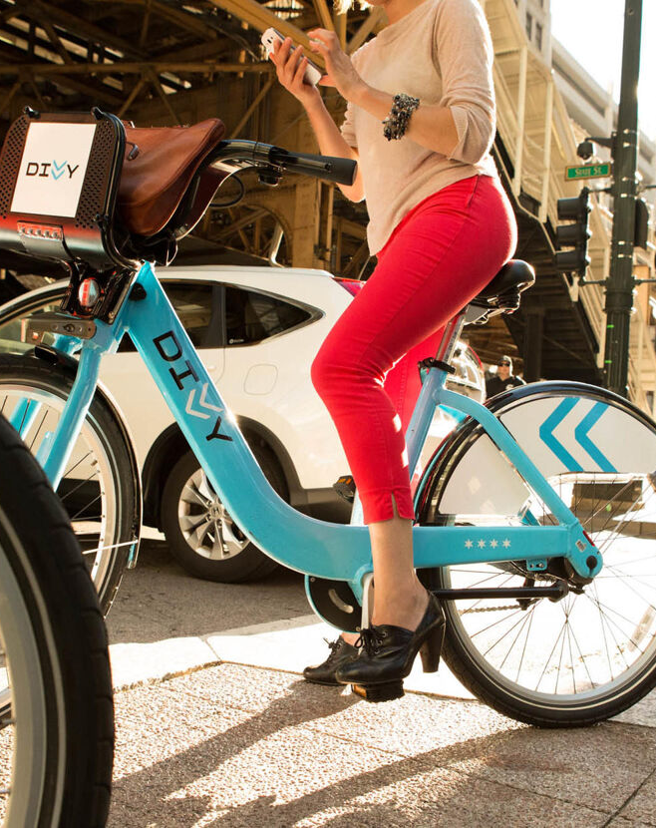
Agenda
Introduction
Business Task
Insights
Recommendations
Notes:
We will approach this conversation in four ways. We will quickly review the problem we are trying to solve, summarize ourbusiness task, share our insights and recommendations. Along the way, we encourage everyone to interject with questions, comments and perspective. With that, let’s jump in…

Slide 3
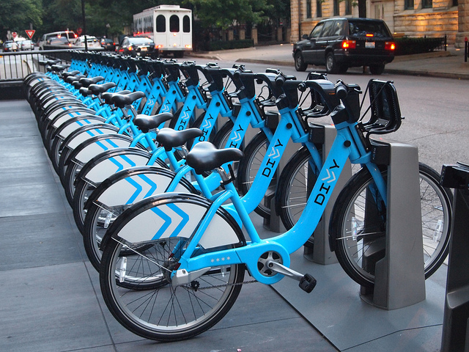
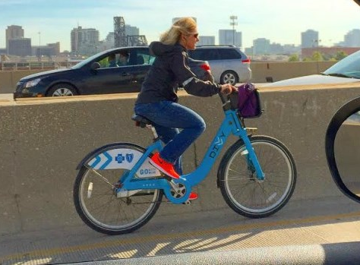
Introduction
Cyclistic, a Chicago-based bike-sharing company, operates a geotracked fleet of bicycles available throughout the city.
Cyclistic classifies riders into two types: casual riders, who purchase single-ride or full-day passes, and members that subscribe to annual memberships.
While offering flexible purchase options attracts customers, Cyclistic's finance department has concluded that members are more profitable than casual riders and need insights to help them develop a conversion strategy.
Notes:
As a quick review, we are a Chicago-based bike-sharing service with two basic types of customers, casual riders who purchase single-ride or day passes, and members, who have subscribed to annual memberships.
We know, based on recent finance analysis that annual members are more profitable than casual riders, and so we want to find opportunities to convert casual riders to member status.

Slide 4
Business Task
Cyclistic's marketing team plans to develop marketing strategies to increase profits by converting casual riders to annual members. To help the marketing team understand this opportunity, analysis will focus on three questions.
1
2
3
How do annual members and casual riders differ?
Why might casual riders buy an annual membership?
How might we use digital media to influence casual riders to become members?
Notes:
So our business task is to use our ridership data to answer three questions that will appropriate inform marketing strategies. We want to know how casual riders are different from members, what might incent casual riders to buy an annual membership, and how we might use digital media to influence this shift.

Slide 5
Notes on Source Data
Used first-party data from Cyclistic that captures individual trip details.
Covers same-day trips taken between January 1, 2022 and December 31, 2022.
Used random sample of 250,000 trips from population of 5,667,717.
Data cleaned and transformed to address missing values, inconsistencies, duplicates and create categorical variables for analysis.
Supplemented with shape files from the Chicago Data Portal for geographical analysis.
Notes:
A brief review the source data we used for this analysis.
We used first-party company data that captures individual trip details for same-day trips taken in 2022.
We chose a random sample of 250,000 trips from a population of 5.67 million trips.
We cleaned and transformed that data and supplemented the dataset with additional data obtained from the Chicago Data Portal in order to incorporate geographical analysis.

Slide 6
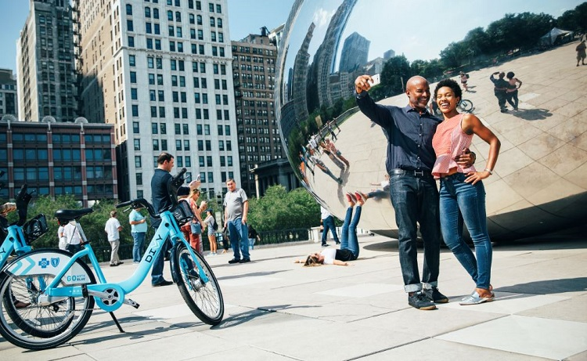
Our Big Idea
Attracting both those seeking a reliable daily commute solution and those looking for exciting ways to experience their city is the best strategy for converting casual riders to members.
Notes:
Our analysis tells us that our digital marketing strategy should incorporate a dual focus on: 1) commuting benefits, and 2) urban exploration as the best way to increase our appeal to a diverse range of potential members.

Slide 7
General Insights
Based on the percent of trips taken each month of 2022, customer engagement with the service is strongest in the warmer months of the year.
5.67 Million
Casual riders and members took 5.67 million trips using the Cyclistic bike-sharing service in 2022.
15 Minutes
On average, customers took trips that lasted 15 minutes in duration with a standard deviation of 8.4 minutes, i.e. 68% of trips last between 6 and 23 minutes.
68%
Most trips are taken during the warmer months of May through September. Marketing efforts should leverage increased activity leading to the summer peak.
Notes:
Let’s start with general insights based on the 2022 data.
You can see from the chart at the top half of the page that there is a seasonality dynamic, i.e. people are more inclined to use the bike-sharing service in favorable weather. In fact, 68% of trips are taken during the warmer months of May though September.
If we are going to focus on converting casual riders into members, months where usage is rising or particularly high can serve as the best opportunities, since overall engagement with the service is strongest during these periods.

Slide 8
Percent of Trips Taken by Casual Riders
Four in every ten trips are taken by casual riders; this proportion highlights a substantial presence of casual riders within the customer base.
40%
Notes:
We found that four in every ten trips (40%) are taken by casual riders. This 40% proportion indicates a substantial presence of casual riders in our customer base.
Given this statistics, Cyclistic should explore increasing the attractiveness of membership options as a way to enable conversion to member status.

Slide 9
While weekdays are a peak period for member trips, weekends are a peak period for casual riders
Notes:
Casual riders show a notable increase in trip counts on Saturdays and Sundays, indicating that weekends are the peak period for this customer type.
Weekday usage for casual riders is low compared to weekend days and remains relatively consistent, with Monday through Thursday showing similar trip counts.
On the other hand, weekdays, particularly Tuesday through Thursday, have the highest trip counts for members.
Members show a decline in trip counts on Saturdays and Sundays, with Saturday having the lowest trip count among all days for this customer type.
We believe this data highlights a need for dual focus that addresses both commuting and urban exploration.
To substantiate this, we examined two things: 1) the duration of trips, and 2) the hourly pattern of trips on weekdays and weekends.

Slide 10
On average, casual riders are spending more time on their bikes than their member counterparts
Notes:
While the average trip duration for both groups is 15 minutes, this chart shows that casual riders and spending more time on bikes than their member counterparts.
We also noted that the average minutes per ride on weekends increases for both groups in comparison to the weekday averages. These longer trips involve more leisurely rides or journeys to destinations farther away.

Slide 11
Hourly trip patterns highlight weekday commute and weekend recreation dynamics
Notes:
On weekdays, there are peak hours for bike-sharing usage between 7:00-9:00 am and 3:00-5:00 pm, highlighting a distinct pattern that corresponds to morning and evening commuting hours.
This indicates that a significant portion of trips is related to daily commuting activities.
On weekends, the usage pattern is more evenly distributed throughout the day, with a single peak in the afternoon between the hours of 3:00 and 4:00 pm. This dynamic, combined with the longer trip duration on weekends, for both members and casual riders, highlights an opportunity to use the concept of urban exploration to create additional value to members (and incent casual riders to invest in memberships).

Slide 12
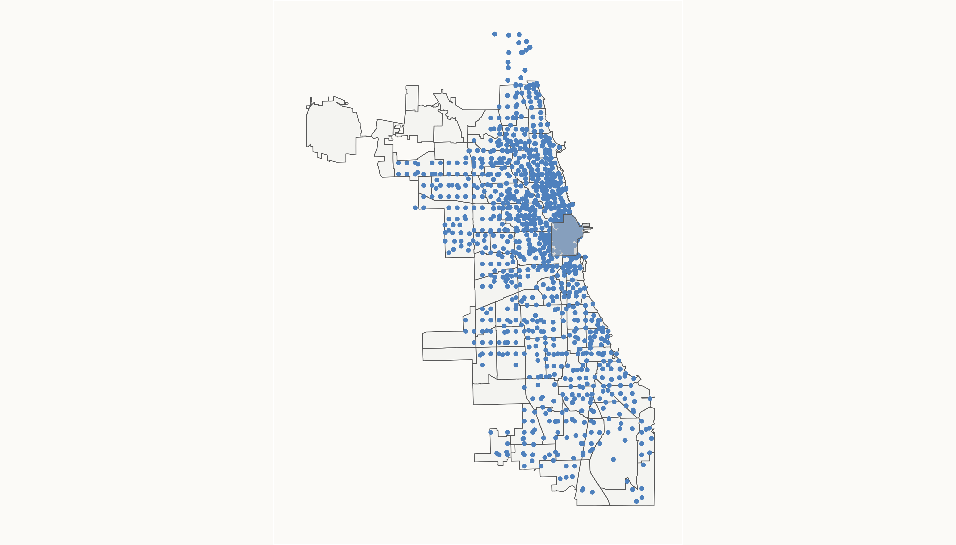
Activity is concentrated in and extends from the central business district throughout the city
Central Business District
The widespread distribution of trips demonstrates that bike sharing is being used by customers across neighborhood and communities in the city.
Notes:
While bike-sharing activity in concentrated in Chicago’s central business district, it does extend out from the CBD to all areas of the city.
The widespread distribution of trip starts and ends throughout the entire Chicago area indicates that bike-sharing is not limited to a specific region but is accessible and used across various neighborhoods and communities.
The concentration of bike-sharing activity in and around Chicago's central Business District (CBD) suggests that the bike-sharing service is heavily utilized in areas where people work, conduct business, or engage in commercial and recreational activities.
The service is well-integrated into the city's transportation network, facilitating point-to-point travel.
The combination of concentrated activity in the CBD and dispersed trips across the city suggests the bike-sharing service caters to diverse needs, including commuting, recreation, and local transportation.
This presents an opportunity to promote bike-sharing as a convenient and eco-friendly way for people to explore the city's diverse neighborhoods, attractions and landmarks.

Slide 13
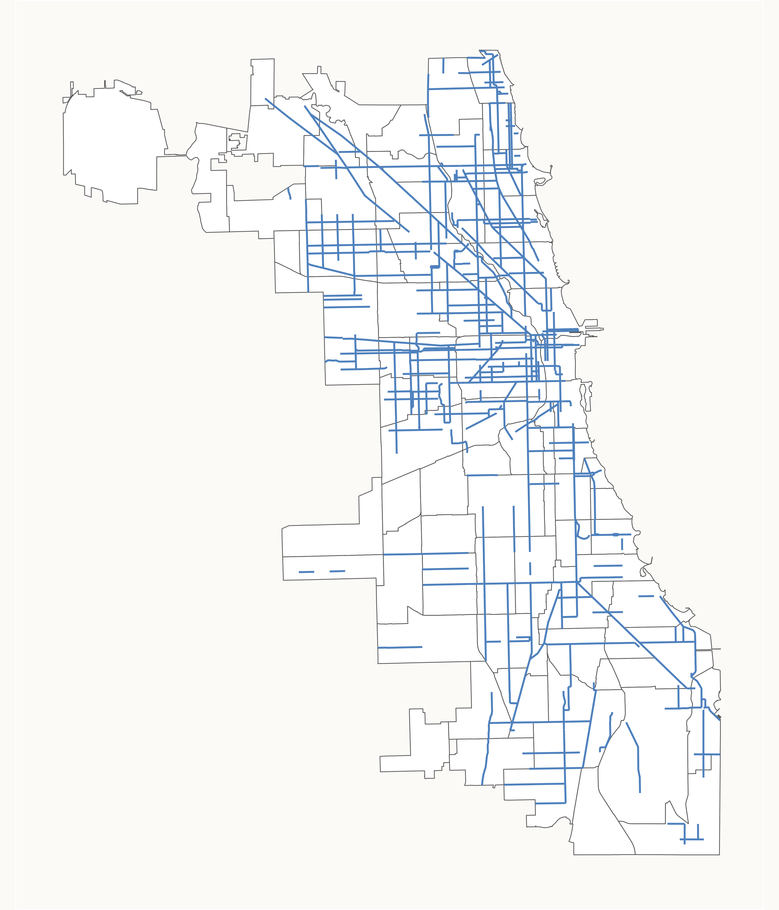
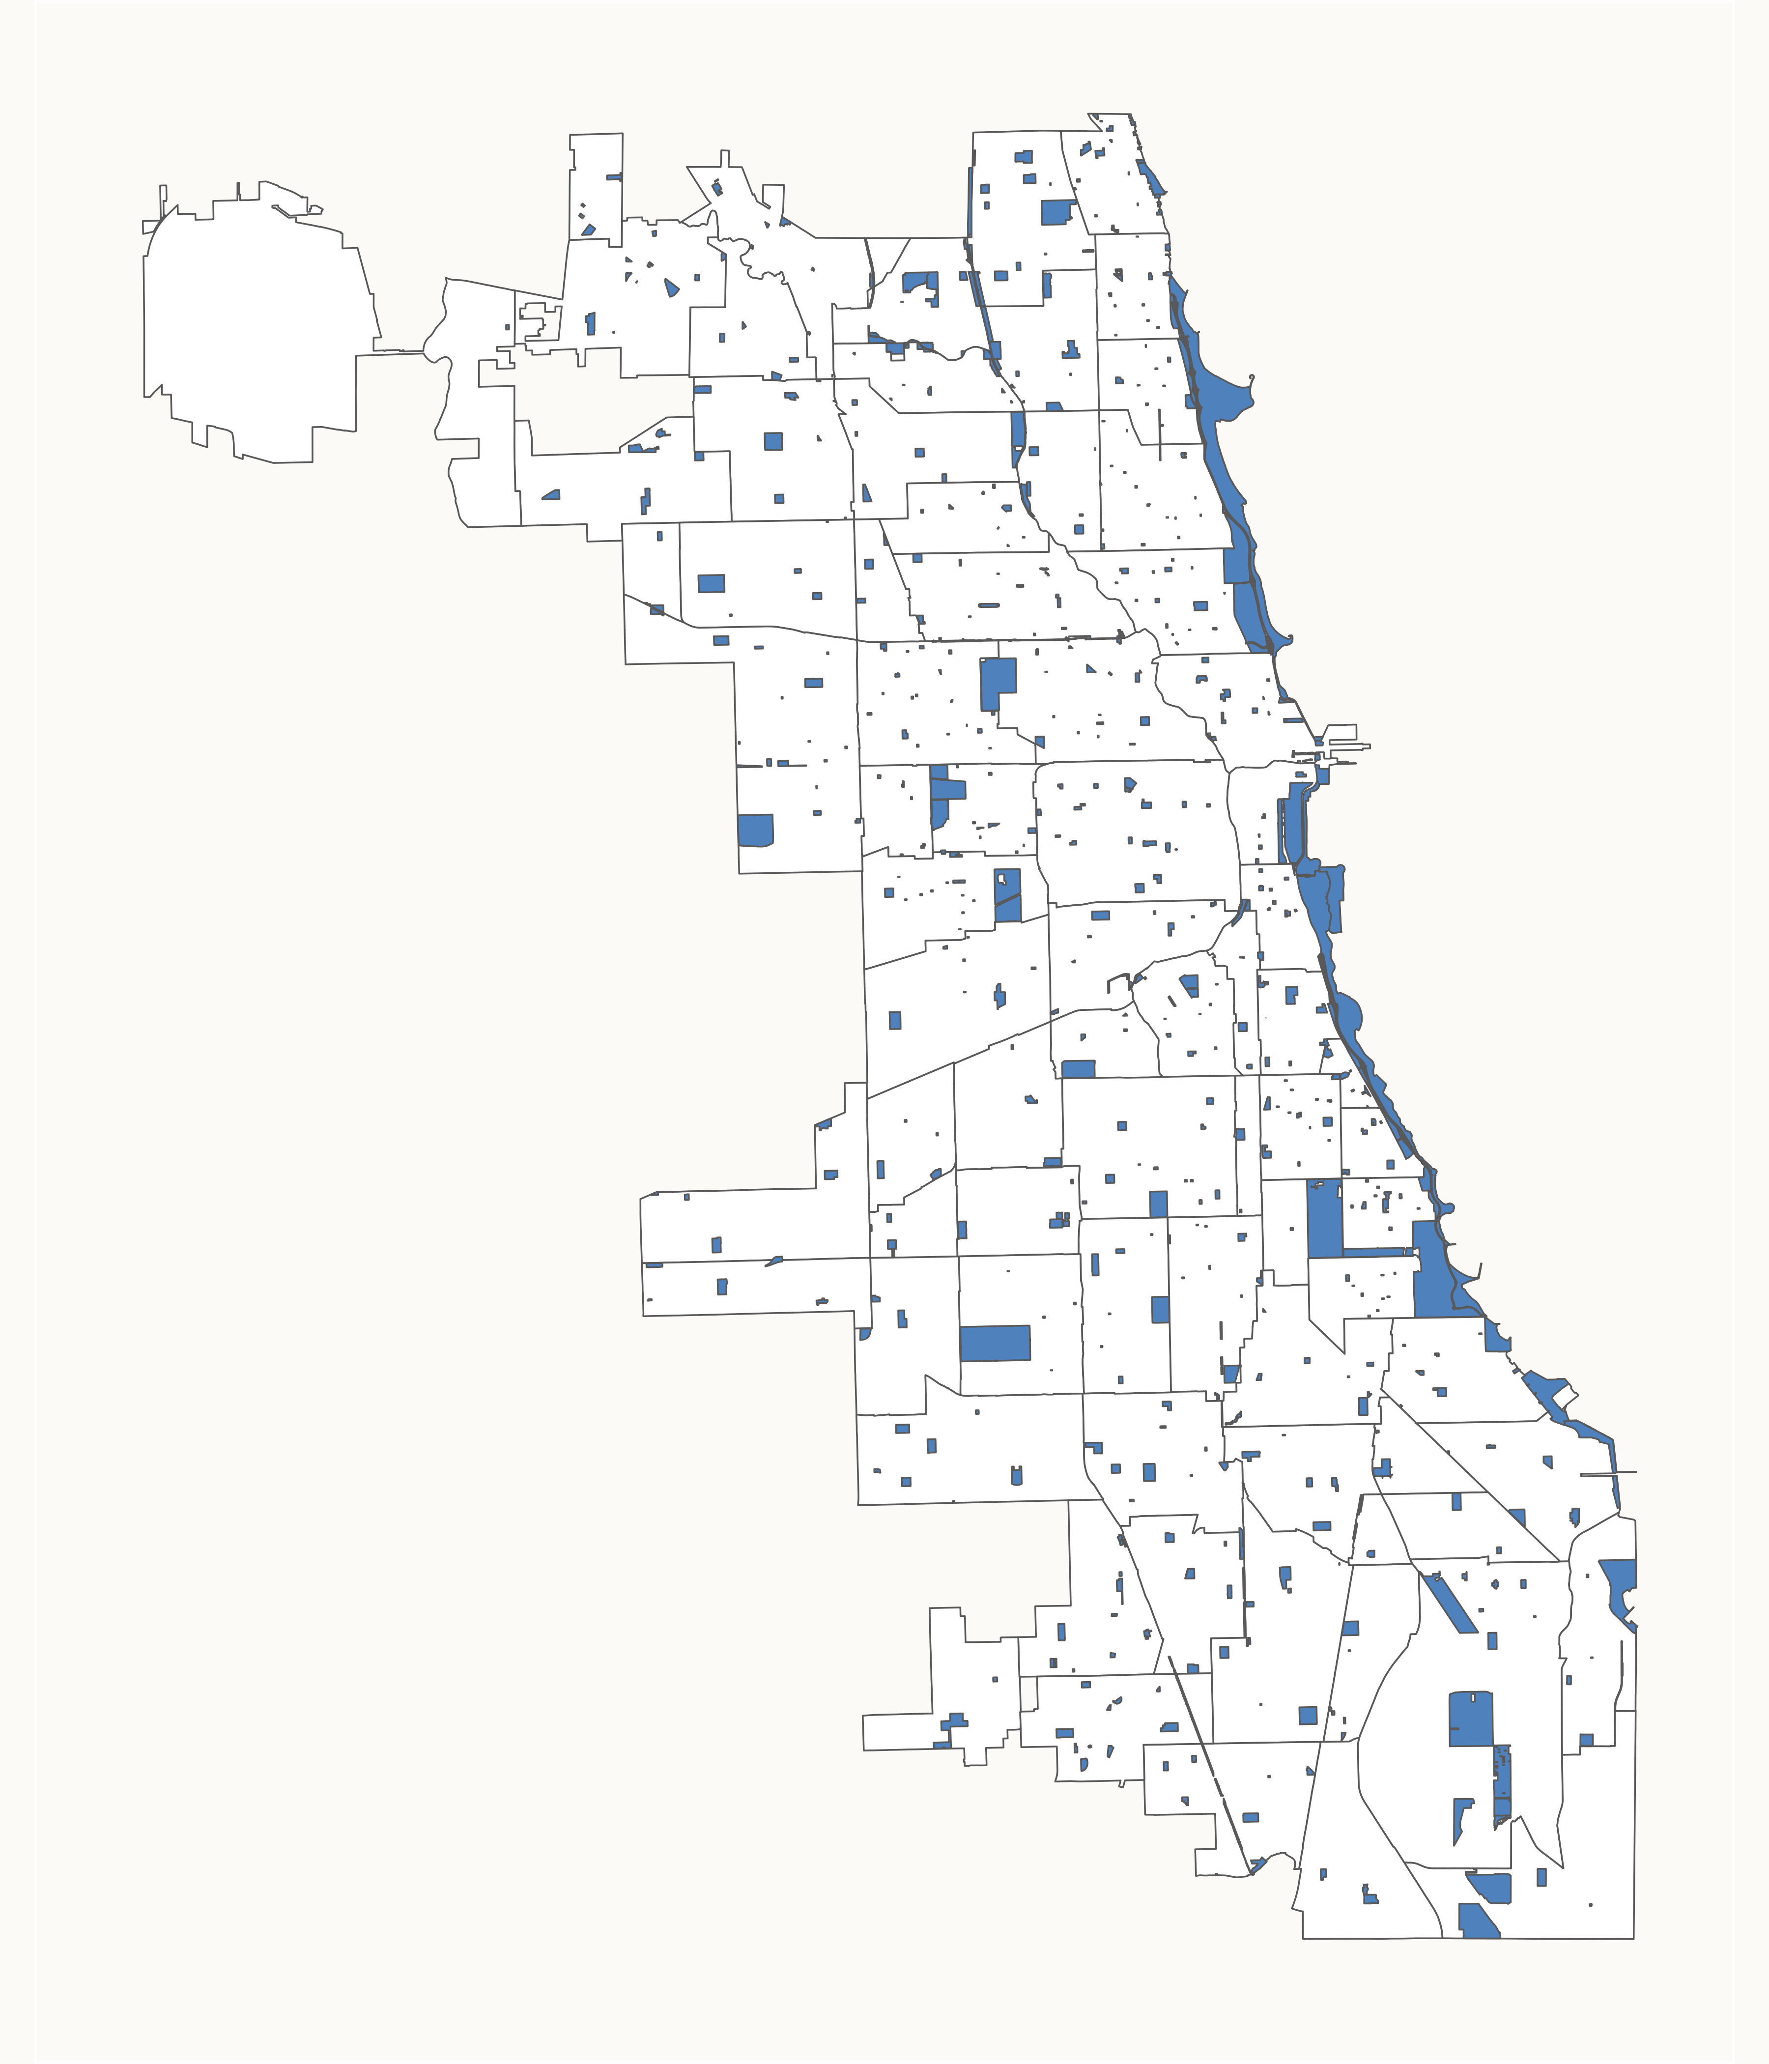
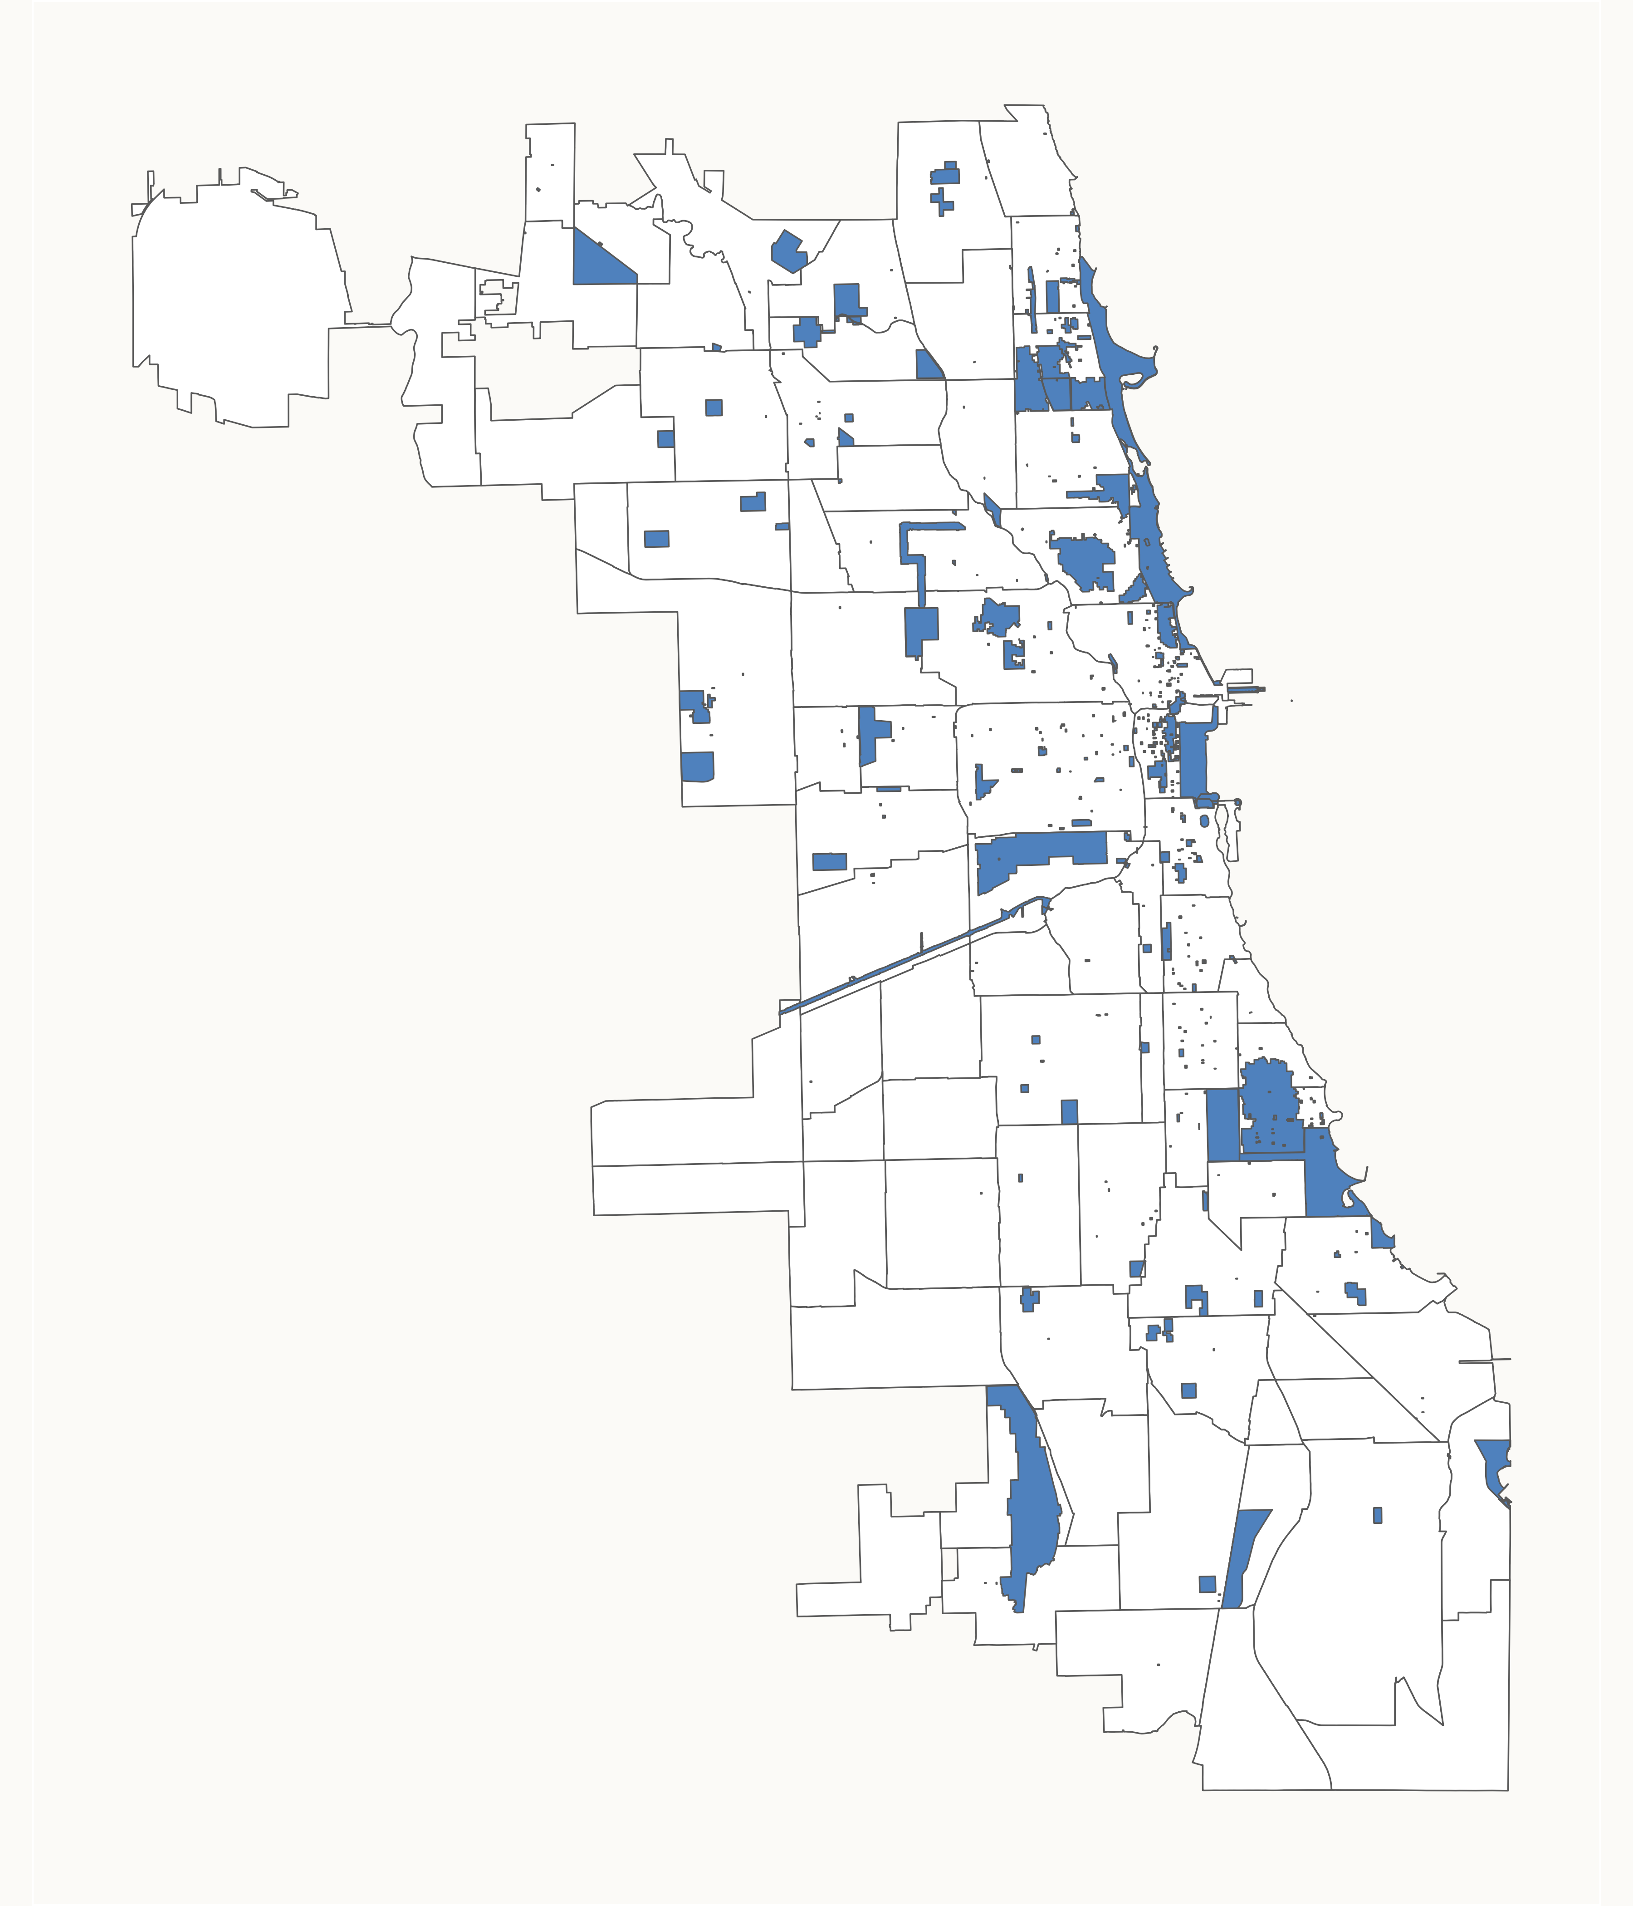
Chicago provides infrastructure and opportunities for urban adventures
953 bike routes covering 369 linear miles
8,868 acres of parks providing recreation opportunities
635 local and national landmarks
Notes:
Chicago provides 953 bike routes covering 369 linear miles, an extensive network of bike routes that makes it feasible for riders to navigate through various parts of the city using bikes.
There are also 8,868 acres of parks providing a broad range of recreation opportunities.
Bike routes that traverse parks often offer scenic and enjoyable paths, making biking a more enjoyable and attractive mode of transportation.
And there are 635 local and national landmarks of cultural significance.
The concentration of landmarks and national landmarks suggests focal points of interest and cultural significance.

Slide 14
Our Recommendations
Showcase the vibrant experiences of commuting and urban exploration with Cyclistic.
Sharing
Encourage customers, especially annual members, to share their commuting and exploration experiences on social media. Use customer-generated content to showcase real-life stories and adventures
Partnerships
Develop partnerships with local businesses, offer additional perks for members, such as discounts or exclusive access to certain services and incentivize casual riders to make the switch.
Storytelling
Use storytelling in marketing materials, social media, and promotions to inspire a sense of adventure and curiosity among casual riders
Promotions
Organize themed rides or events highlight unique landmarks, cultural hotspots, and hidden gems. Use value-added guides or curated routes for annual members, showcasing the best routes for urban exploration.
Notes:
Given these insights, we recommend a strategy that showcases the benefits of commuting and urban exploration via Cyclistic.
This strategy has four parts:
Craft compelling narratives to ignite curiosity among casual riders through storytelling in marketing, social media, and promotions.
Foster community engagement by encouraging customers, especially annual members, to share their biking experiences on social media, creating authentic content that showcases real-life stories and adventures.
Establish partnerships with local businesses to provide exclusive perks, discounts, and services for members, incentivizing casual riders to transition.
Organize urban adventure events and themed rides, highlighting unique landmarks and cultural hotspots, while offering value-added guides for annual members to enhance their urban exploration experience.

Slide 15

"Pedal through our city streets, turning your daily commute into an urban adventure. Bike-sharing is the key to practicality and exploration – unlock the city with every turn."
– Donnie Minnick
Notes:
This collection of recommendations sets up Cyclistic to appeal to customer sense of practicality and exploration in a way that will expand memberships.

Slide 16
Future Opportunities
Incorporate customer feedback for more nuanced understanding of motivations and preferences.
Data on bicycle availability to assess impacts on usage patterns.
Analysis of customer demographics, e.g. age, fitness level, cycling experience.
Analysis of pricing and how it influences usage, e.g. trip duration, usage over time.
Mode of transportation integration and possible “last mile” dynamic in customer behavior, i.e. using bike sharing as last leg of journey.
Notes:
While the trips data was useful for generating insights into customer usage of the bike-sharing service, some enhancements would be beneficial to future analyses.
Conduct surveys or gather user feedback to understand the motivations and preferences of both casual riders and members.
Data on bicycle availability would enable Cyclistic to assess how availability impacts usage patterns.
Analysis of pricing and how it influences customer behavior, e.g. trip duration, usage over time, etc.
Analysis of customer demographics and how this influences usage, i.e. age, fitness level, cycling experience.
Mode of transportation integration, i.e. how are casual riders and members integrating the service with other modes of transportation? Is there a "last mile" dynamic present in customer behavior, i.e. using the bike-sharing service for the final leg of a journey, typically from a transportation hub (like a train or bus station) to the final destination, which might be just a short distance away. This data could shed additional light on why there are so many short-duration trips in the data

